Slide 1
GROUP 25
PRESENTATION

Slide 2
PROBLEM
1. Illustrate how you would build a Egyptian pyramid with
b=7cm, l=4cm, h=3cm as the using a set of triangular
meshes. Show the implementation in OpenGL and also
blender

Slide 3
TRIANGULAR MESHES
A triangular mesh is a collection of triangles that are connected together to form a 3D surface or shape.
Each triangle is defined by 3 points (called vertices) in 3D space.

Slide 4
TRIANGULAR MESHES
A triangular mesh:
Is made up of vertices (points),
Edges (lines between vertices), and
Faces (triangles formed by connecting 3 vertices).
They’re used to approximate curved or flat surfaces by breaking them into many small triangles.

Slide 5
TRIANGULAR MESHES
Why Use Triangles?
Triangles are always planar (any 3 points define a flat surface).
They are the simplest polygon possible.
They're fast and efficient for GPUs to render.
Any complex shape can be built from them.

Slide 6
1. BLENDER
Triangular meshes can be implimented using 3D Modelling Software in our case blender

Slide 7
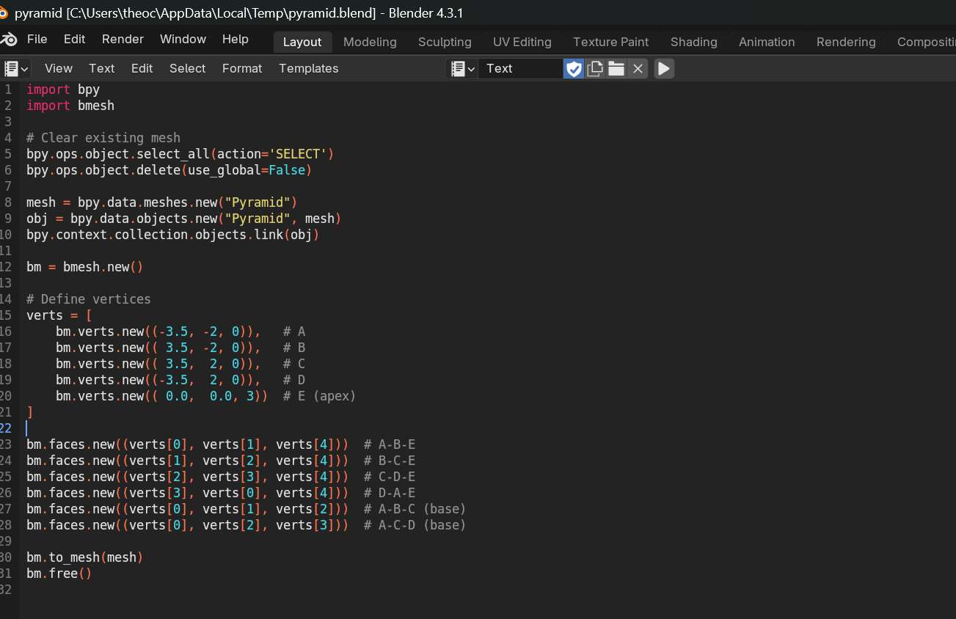
PROCESS
In Blender, you can create the pyramid using the bpy Python API
bpy is the main API for interacting with Blender — everything you see in the interface (objects, scenes, meshes, materials, animations, etc.) can be accessed or controlled through bpy
bmesh is a low-level geometry module for creating and editing mesh data more easily and precisely.
It’s Blender’s editable mesh system — lets you work with vertices, edges, and faces directly in memory before converting to a final mesh.

Slide 8
Line 5,6 Selects all objects in the current scene and deletes them, so we start with a clean slate
bpy.data.meshes.new("Pyramid") creates an empty mesh named "Pyramid".
bpy.data.objects.new("Pyramid", mesh) wraps that mesh into an object.
bpy.context.collection.objects.link(obj) adds the object to the current scene so it becomes visible.
bmesh.new() creates a BMesh — Blender’s internal format for procedural geometry. It's more flexible than editing a regular mesh directly.

Slide 9
Line 15-10 defines 5 points (vertices) in 3D space.
These correspond to the 4 corners of the base and 1 apex (top) of the pyramid.
The base lies on the XY plane (z=0), and the apex is at height z=3.
Line 23-28 create the faces(side triangels)
The first 4 triangles form the slanted sides of the pyramid, each using:
2 base vertices
The top (apex) vertex
The last 2 triangles form the base of the pyramid (a rectangle split diagonally into 2 triangles)
Even though the base is a rectangle, 3D graphics work better with triangles only, so we divide it.

Slide 10
Converts the BMesh into a real Blender mesh so it can be rendered and edited.
Frees the BMesh from memory (cleanup step).

Slide 11
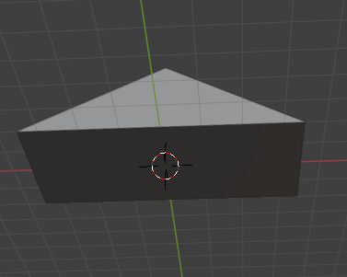
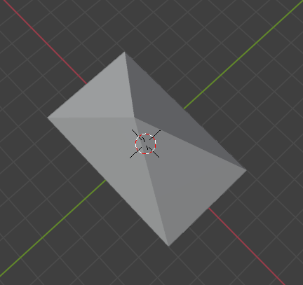
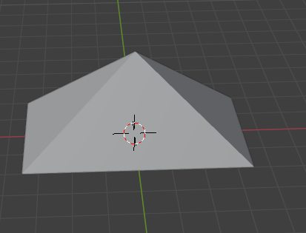
You now have a pyramid with:
4 triangular sides
1 rectangular base, made of 2 triangles

Slide 12
2. OPEN GL
What is OpenGL?
A cross-platform graphics API used for rendering 2D and 3D graphics.
Purpose in this assignment:
To render a 3D solid pyramid

Slide 13
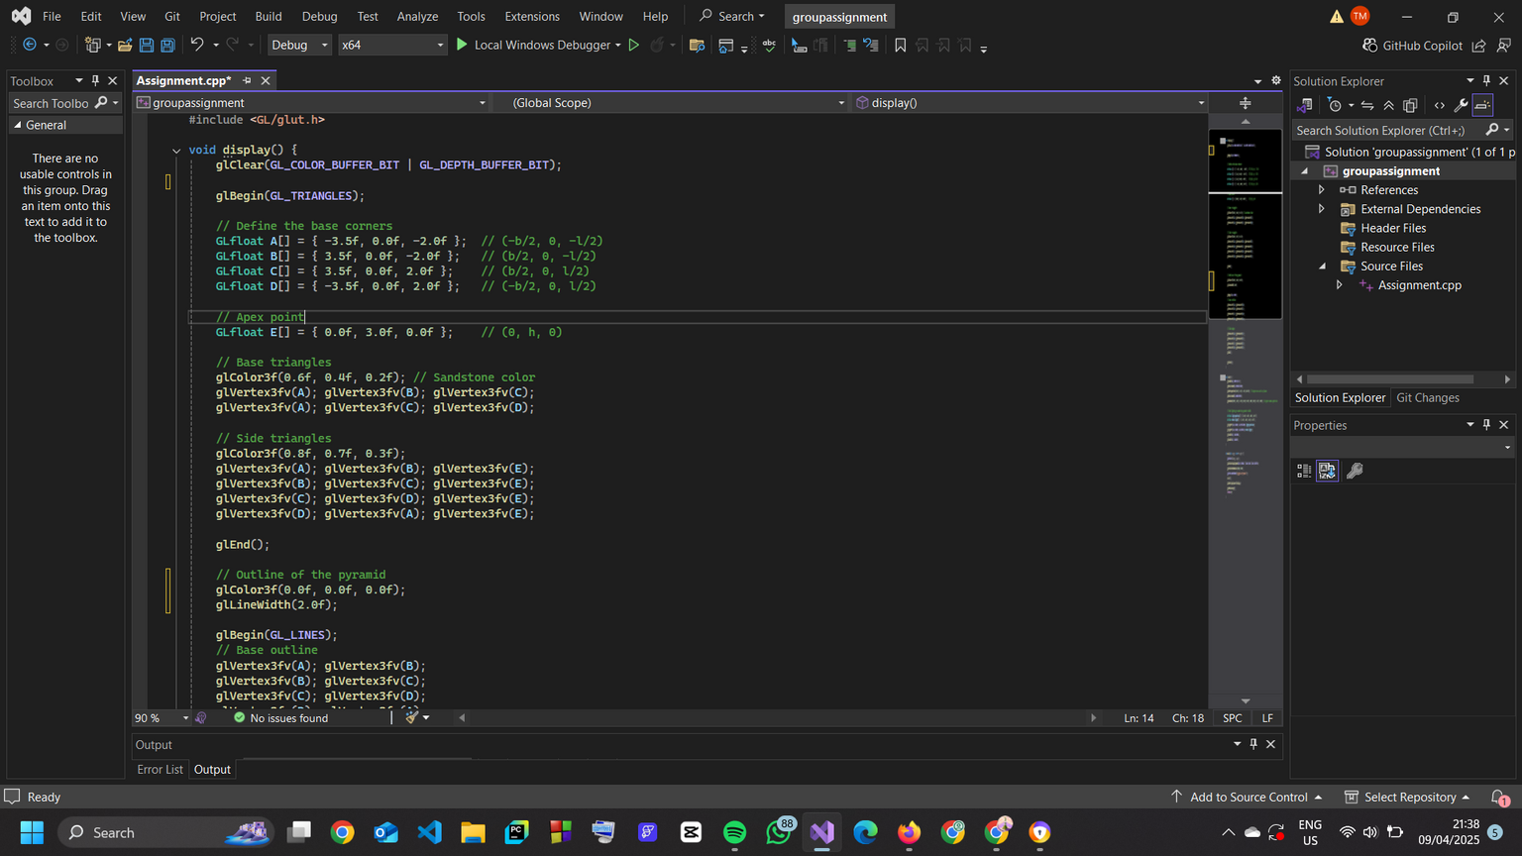
#include <GL/glut.h>
This line includes the GLUT (OpenGL Utility Toolkit) library. GLUT simplifies the process of creating windows, handling input, and managing rendering in OpenGL.
void display()
Declares the main display function, where the 3D pyramid is drawn
glClear(GL_COLOR_BUFFER_BIT | GL_DEPTH_BUFFER_BIT)
Clears the colour buffer (the screen) and the depth buffer (used for 3D layering).

Slide 14
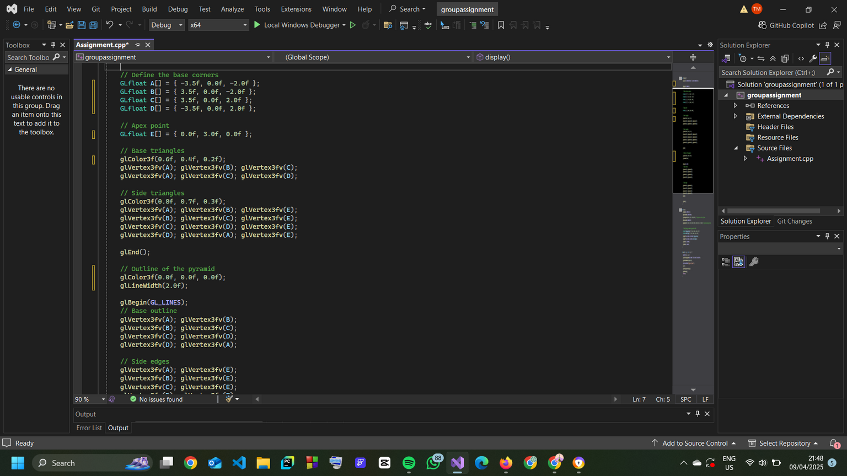
Define Base Vertices
Defines 4 vertices (A, B, C, D) of the base of the pyramid.
Coordinates: x = left/right, y = up/down, z = front/back.
y = 0 → all are on the ground plane.
Define Apex (Top Point)
The apex of the pyramid, centered above the base.
Draw Base (2 Triangles)
glColor3f sets the base color: R=0.6, G=0.4, B=0.2
First triangle: A-B-C
Second triangle: A-C-D

Slide 15
Draw Side Faces (4 Triangles)
glColor3f(0.8f, 0.7f, 0.3f)
Each triangle connects two adjacent base vertices to the apex (E).
This creates the 4 triangular side faces of the pyramid.
Base Outline Lines
Connects A-B-C-D-A to outline the base perimeter.

Slide 16
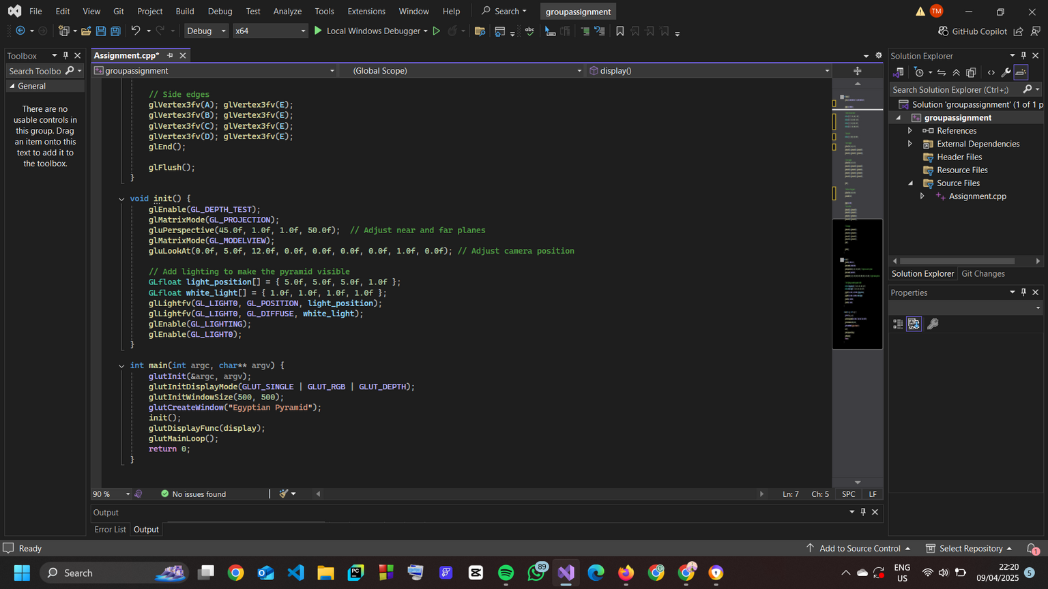
Side Edges to Apex
Draws lines from each base corner to the top point (E).
void init()
This function sets up the initial configuration of your 3D scene: depth testing, projection setup (camera view), and lighting.
glEnable(GL_DEPTH_TEST)
It enables depth testing,so that OpenGL correctly renders which objects are in front and which are behind.

Slide 17
glMatrixMode(GL_PROJECTION)
This matrix controls the camera lens, how the 3D world gets projected onto a 2D screen
gluPerspective(45.0f, 1.0f, 1.0f, 50.0f)
Makes your pyramid look realistic with depth
glMatrixMode(GL_MODELVIEW)
Switches matrix mode back to the model-view matrix.This is used for placing objects and the camera in the scene.
Lighting Setup
Sets the position and colour (white) of the light.
The 1.0f as the last value means positional light (not directional).
Configures light 0 with the position and color.
Turns on OpenGL lighting and enables the specific light (GL_LIGHT0).

Slide 18
glutInit(&argc, argv)
Initializes GLUT, passing in command line arguments.
glutInitDisplayMode(GLUT_SINGLE | GLUT_RGB | GLUT_DEPTH)
GLUT_SINGLE: single-buffered window (draws directly to the screen).
GLUT_RGB: use RGB colors.
GLUT_DEPTH: use depth buffering.
init()
Calls your custom init() function to set up camera, lighting, and perspective.
glutDisplayFunc(display)
Registers the display function as the callback for redrawing the window.
glutMainLoop()
Starts the GLUT event loop. This keeps the window open and responsive.

Slide 19
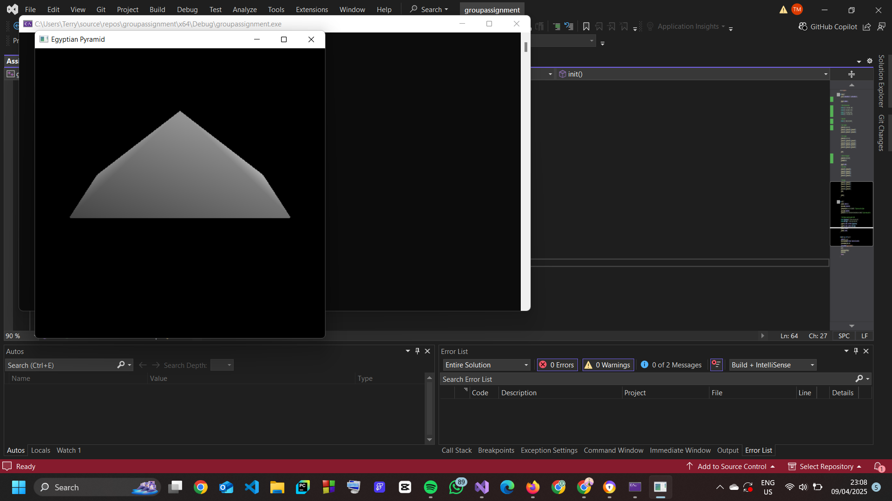

Slide 20
THANK
YOU

